Slide 1
Humanitarian Relief Distribution Game
Sinan Salman, PhD
Suzan Alaswad, PhD
Zayed University
UNHCR: 65.6 million forcibly displaced people in the world in 2018. Photo: AFP
Introduction
Notes:
Note: Some of the material used here is based on slides by Dr. Kai Riemer, http://www.beergame.org

Slide 2
Supply Chain Management for Humanitarian Relief
Source: UNHCR

Slide 3
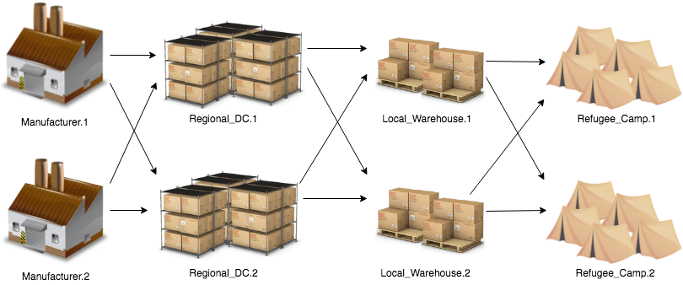
Introduction
This game simulates supply chain operations in humanitarian relief distribution:

Slide 4
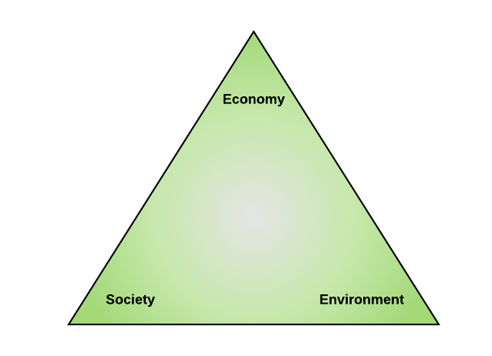
Introduction
Game objective: The Triple Bottom Line
Satisfy beneficiary demand,
Minimize total cost of the supply chain, and
Minimize environmental impact

Slide 5
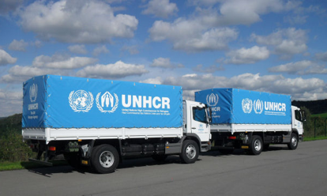
Introduction
Each item in inventory incur a weekly holding cost ($1/item)
Beneficiary service levels are measured by the availability of relief items in the right place at the right time.
If relief items are not available when beneficiaries need it, a backorder cost is incurred ($2/item) (every week until it is met)
Transportation environmental cost $220/truck
A truck can transport a maximum of 200 items
Lower utilization ⇒ higher impact

Slide 6
Introduction
Each week managers of every station must decide on:
The number of items to ship downstream
The number of items to order from upstream supplier
This is in order to have a good level of beneficiary service, minimize costs, and reduce the environmental impact

Slide 7
Weekly Operations Steps
Receive incoming goods from Supplier (inventory ↑)
Receive incoming order from customer
Decide on:
Shipment to customer (inventory ↓)
Order from supplier
Both are entirely your decision.
Keep your cost low, your customer satisfied, and environment safe
inventory $1/item + backorder $2/item + environmental impact $220/truck
Submit

Slide 8
Game User Interface
Station/Week info
Performance
Game Status
Deliveries/orders from/to suppliers
Station inventory/backorder
Orders/shipments from/to Customers

Slide 9
Rules:
Beneficiaries will wait forever!
Orders must be fulfilled, in the current week (if stock is available) or in the future (backorders)
Consider the supply chain delays
1 week delay before an order arrives at the supplier (communication)
2 weeks delay before shipped goods arrive from the supplier (Logistics)
Watch your time!
Like in real life, time waits for no one. 1 week = 1 minute.
This is a Competitive-cooperative game
Protect your information confidentiality!

Slide 10
The Stations

Slide 11
READY, SET, GO!

Slide 12
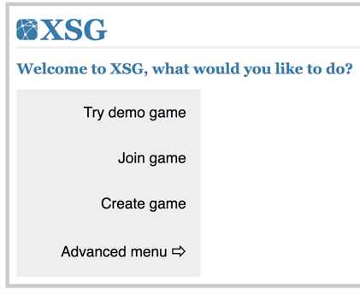
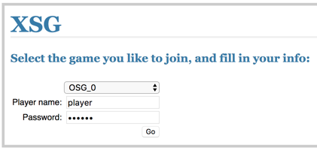
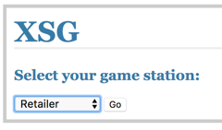
How to Start
Game URL: https://istm.zu.ac.ae/xsg
Click on “Join game”
Enter your team, name, password (Provided by instructor), and click on “GO”
Select your position (Provided by instructor), and click on “GO” to begin the game

